Slide 1
Distance Protection

Slide 2
Distance Protection
Popular, widely used on Sub-Transmission and Transmission Systems
Virtually independent of Fault Current Level (Z_{S}/Z_{L} ratios)
Fast Discriminative Protection:-
Zone 1 or ‘Aided’ Distance Scheme
Time Delayed Remote Back-Up.

Slide 3
Overcurrent weakness for line protection:
Z_{S} = 10 Ω
Z_{L} = 4 Ω
Z_{S} = 10 Ω
I_{F1}
F₁
115kV
50
I_{F1} = 115kV/√3(5+4) = 7380A
∴ I_{s} > 7380A

Slide 4
Advantages of Distance Protection
Consider One source is out of service
Z_{S} = 10 Ω
I_{F2}
F₂
50
I_{F2} = 115kV/√3 x 10 = 6640A
∴ I_{s} <6640A
>7380A - IMPRACTICAL

Slide 5

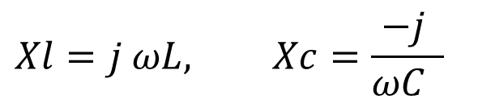
Simplified Line Diagram
L
R
L
R
L
R
L
R
C
C
C
$$Xl=j ωL, Xc=\frac{−j }{ωC }$$
L
R
at F_{N} (60Hz) X_{C} = large
$$Zl=R+j ωL$$

Slide 6
Impedance Seen By Measuring Element
jX
Z_{L}
R

Slide 7
Basic Principle of Distance Protection
Z_{S}
Z_{L}
Generation
I_{R}
Distance
Relay
21
V_{R}

Slide 8
Basic Principle of Distance Protection
Relay
PT.
Z_{S}
I_{R}
Z_{L}
Z_{LOAD}
Normal Load
V_{S}
V_{R}

Slide 9
Basic Principle of Distance Protection
Z_{L}
Z_{S}
I_{R}
Z_{F}
V_{S}
V_{R}
Z_{LOAD}
Fault
Impedance Measured Z_{R} = V_{R}/I_{R} = Z_{F}
Relay Operates if Z_{F} < Z where Z = setting
Increasing V_{R} has a Restraining Effect ∴
V_{R} called Restraining Voltage
Increasing I_{R} has an Operating Effect

Slide 10
Plain Impedance Characteristic
jX
Z_{L}
Impedance Seen At Measuring Location For Line Faults
R
TRIP
STABLE

Slide 11
Impedance ratio factor:
I₁/I₂
Z_{P}
I_{R}
V₁
21
V_{R}
V₂
V_{FP}
Relays are calibrated in secondary ohms :-

Slide 12
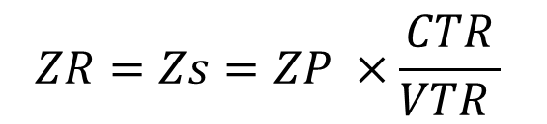
Example
Z_{P} = 4Ω;
VTR= V₁/V₂ = 115kV/115V =1000;
CTR= I₁/I₂ = 600/5A = 120
CTR= I₁/I₂ = 600/1A = 600
$$ZR=Zs=ZP ×\frac{CTR}{VTR }$$
ZR(5) = 4 x (120/1000) = 0.48Ω -5A Relay
ZR(1) = 4 x (600/1000) = 2.4 Ω -1A Relay

Slide 13
Input Quantities for ∅-∅ Faults
FAULT V_{RESTRAINT} I_{OPERATE}
A - B V_{A} - V_{B} I_{A} - I_{B}
B - C V_{B} - V_{C} I_{B} - I_{C}
C - A V_{C} - V_{A} I_{C} - I_{A}
V_{RESTRAINT} & I_{OPERATE} are selected inside the relay
No setting adjustments are required apart from

Slide 14
Neutral Impedance Replica Vectorial Compensation ( A-N fault)
Replica impedance circuit :-
I_{RA}
Z₁
Z₁ = Phase replica impedance
Z_{N} = Neutral replica impedance
I_{RA} passes through Z₁
I_{RN} passes through Z_{N}
Z_{T} = Z₁ + Z_{N}
Z₁
Z₁
I_{RN}
Z_{N}
N

Slide 15
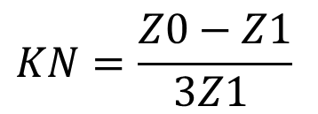
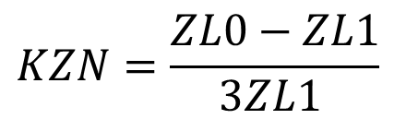
Neutral Impedance Compensation
(reference calculation)
For a single phase to ground fault the total earth loop impedance is given by :
- (Z₁ + Z₂ + Z₀)/3 = Z_{T}
Z_{T} = (Z₁ + Z₂ + Z₀)/3 = Z₁ + Z_{N} ( in replica circuit)
Z_{N} = (Z₁ + Z₂ + Z₀)/3 - Z₁
= (2Z₁ + Z₀)/3 - Z₁
= - Z₁ + Z₀
= K_{N} Z₁
3
3
$$KN=\frac{Z0−Z1}{3Z1 }$$
$$KZN=\frac{ZL0−ZL1}{3ZL1 }$$

Slide 16
Distance Characteristics

Slide 17
Distance Characteristics
jX
jX
jX
jX
Z_{n}
Z_{n}
Z_{n}
Z_{n}
R
R
R
R
MHO
OFFSET
MHO
Z_{s}
Z_{n}′
IMPEDANCE
CROSS-
POLARISED
MHO
jX
Z_{n}
Z_{n}
Z_{n}
R
R
R
LENTICULAR
QUADRILATERAL
POLYGON

Slide 18
Self Polarised Mho Relays
Very popular characteristic
Simple
Inherently directional
Operates for F₁,
Not for F₂ or F₃
jX
RESTRAIN
F₂
Z
OPERATE
F₁
Settings :-
Z = reach setting ϕ = characteristic angle
ϕ
R
F3

Slide 19
Offset Mho Characteristic:
Normally used as backup protection
Operates for zero faults (close up faults)
Generally time delayed (as not discriminative)
jX
Z
R
-Z’

Slide 20
Quadrilateral Characteristic
jX
ZL
Z1
Load
Rf
R
R

Slide 21
Protection Zone

Slide 22
Zones of Protection
Time
Z3A
Z3C
T3
T2
Z2A
Z2C
Z1A
Z1C
A
Z1B
B
C
D
T2
Z2B
Z1A = 80% of Z_{AB}
Z2A = 120% of Z_{AB}
Z3A(FORWARD) = 120% of {Z_{AB} + Z_{CD}}

Slide 23
Zones of Protection ( Mho)
jX
D
Z3A
C
Z2A
B
Z1A
A
R

Slide 24
Zone 1
FAST OPERATION
Trips circuit breaker without delay as soon as
fault within Zone 1 reach is detected.
REACH SETTING
Cannot be set to 100% of protected line or may
overreach into next section.
Overreach caused by possible errors in :-
CTs
VTs
Z_{LINE} information
Relay Measurement

Slide 25
Zone 1
Possible
Overreach
ZONE 1 = Z_{L}
Z_{L}
F
Possible incorrect tripping for fault at ‘F’
∴ Zone 1 set to ∼ 0.8Z_{L}
ZONE 1 = 0.8Z_{L}
Z_{L}

Slide 26
Minimum Zone 1 Reach Setting
Dictated by :-
Minimum relay voltage for fault at Zone 1
reach point to ensure accurate measurement.
Minimum voltage depends on relay design
typically 1 → 3 volts.

Slide 27
Zone 2
Covers last 20% of line not covered by Zone 1.
Provides back-up protection for remote busbars.
To allow for errors :-
  Z2G > 1.2 Z_{GH}
Zone 2 is time delayed to discriminate with Zone 1 on next section for faults in first 20% of next section.
Z2G
TIME
Z1G
Z1H
G
H
F

Slide 28
Zone 2
Zone 2 on adjacent line sections are not normally time graded with each other
Z2G
Z2H
Z1G
Z1H
‘G’
‘H’
F
Overlap only occurs for faults in first 20% of following line.
Faults at ‘F’ should result in operation of Z1H and tripping of circuit breaker ‘H’.
  If ‘H’ fails to trip possible causes are :-
  ➔ Z1H operates but trip relays fail.
  Z2H may operate but will not trip if followed by the same trip relays.
  Fault must be cleared at ‘G’ by Z2G.
  Z1H and trip relays operate but circuit breaker fails to trip.

Slide 29
Zone 3
Provides back-up for next adjacent line.
Provides back-up protection for busbars (reverse offset).
Actual Zone 3 settings will be scheme specified, i.e. permissive or blocking schemes.
Many modern relays have more than 3 Zones to allow the use of three forward and an independent reverse zone.
Z3G REV
Z3G FWD
Z2G
Time
Z1G
Z1H
G
H
K
Typical settings : Z3FWD > 1.2 x (Z_{GH} + Z_{HK})
Z3REV 0.1 to 0.25 of Z1G

Slide 30
Zone Time Coordination - Ideal Situation
Zone 1 :- tZ1 = instantaneous (typically 15 - 35mS)
Zone 2 :- tZ2 = tZ1(down) + CB(down) + Z2(reset) + Margin
e.g. tZ2 = 35 + 100 + 40 + 100 = 275mS
Zone 3 :- tZ3 = tZ2(down) + CB(down) + Z3(reset) + Margin
e.g. tZ3 = 275 + 100 + 40 + 100 = 515mS

Slide 31
MiCOM Distance features

Slide 32
MiCOM P54x/P44X
Distance protection - Introduction
P54x/P44X Use Superimposed Current
Proven DELTA technology
Compares pre-faulted system
Acts as a fault detector and faulted phase detector
Can quickly recognize evolving faults and power swings
Provides secure phase selection for complex fault conditions
Sensitive to any fault type
Notes:
Phase selection is necessary to ensure that the right mho/quad elements according to the fault type are allowed to decide whether to trip.
Phase selection avoids elements on unfaulted phases from tripping, eg:
“A” phase fault presents a “ghost” impedance on phases B and C due to all elements relying on residual current in the fault loop calculation. Operating on the wrong phase risks a single pole trip being converted wrongly to a 3 phase trip, or worse a forward trip for a reverse fault.
As voltage collapses for a single phase fault, this also collapses certain phase-phase voltages (eg A-phase fault reduces Vab and Vca too). With heavy remaining load, this can also risk a three phase trip.
In 3 pole tripping applications, bad phase selection might mean wrong fault flagging (targetting).
Delta I phase selection as in P442 and LFZR is VERY good:
No need to set any I>>, V<, Z< starters to avoid ghost impedances
No settings - the delta is factory set and its sensitivity automatically applied on all systems without any need to set or adjust.

Slide 33
MiCOM P54x/P44X
Faulted = Unfaulted + Superimposed
Prefault
Fault
Current:-
i
i
rly
=
mem
+
i
r
= Superimposed
Notes:
The voltage signal (v_{r}) equals the unfaulted voltage (v_{pr}) plus the superimposed voltage (v_{r} ). The current signal (i_{r}) equals the unfaulted current (i_{pr}) plus the superimposed current(i_{r} ). Prior to the fault the superimposed signals are zero. The slide shows a forward fault. Initially the superimposed signals are of opposite polarity, but thereafter the polarity relationship varies with time due to the phase shift introduced by the source angle.

Slide 34
MiCOM P54x
Superimposed Components
2 cycle window
Notes:
Phase selectors measure phase to phase: A-B, B-C, C-A.
In this case:
CA is the largest delta
BC is above 80% of the largest delta, and so is “included”
AB is less than 80% of CA delta, so is excluded
The common phase in BC and CA is phase “C”
So it is a C phase ground/earth fault

Slide 35
MiCOM P54x/P44X
Distance Zones, Mho Characteristics
Avalable for Phase and Ground Protection (21P and 21G)
Three independent Forward zones
  Z1, Z2, Z3
  Z3 optional forward/reverse offset
One Reverse zone
  Z4
Programmable Fwd/Rev zone
  Zone p
Z3
Zp
Z2
Z1
Z4
Notes:
Zone designations are chosen as per P442 family.
Zone 1, 2 and 3 ALWAYS forward looking.
Zone 4 ALWAYS reverse looking (eg. For use in channel aided schemes as reverse fault signalling).
Zone p is programmable to look FWD or REV.
Note that to ensure tripping for a close-up zero voltage fault, for a switch on to fault (SOTF) where the memory is unavailable, Zone 1 transiently has a reverse offset = 20% of forward reach.
Zone 3 can be set with a forward or reverse offset from the origin, which is set as a percentage of the forward reach (easier than in LFZR).

Slide 36
Distance Zones, Quatrilateral Characteristics
Avalable for Phase and Ground Protection (21P and 21G)
Independently selectable
  eg. Mho phase + quad
  ground fault
Z3 (reverse offset)
Z2
Z1
Zp
(if reverse
looking)
Z4
Notes:
Zone designations are chosen as per P442 family.
Zone 1, 2 and 3 ALWAYS forward looking.
Zone 4 ALWAYS reverse looking (eg. For use in channel aided schemes as reverse fault signalling).
Zone p is programmable to look FWD or REV.
Note that to ensure tripping for a close-up zero voltage fault, for a switch on to fault (SOTF) where the memory is unavailable, Zone 1 transiently has a reverse offset = 20% of forward reach.
Zone 3 can be set with a forward or reverse offset from the origin, which is set as a percentage of the forward reach (easier than in LFZR).

Slide 37
MiCOM P54x/P44X
Distance protection, loadblinders
Blinder Allows Stability Notch around Load
X
Z
Blinder
Angle
Load Area
R
Blinder Impedance
Setting
Notes:
The blinder is basically formed from an underimpedance circle, with radius set by the user; and two blinder lines crossing through the origin.
The blinder cuts a notch out of the side of distance zones, to avoid heavy load.
We always recommend that the blinder should be set, for added security.
Set the blinder angle half way between the worst case power factor angle, and the line impedance angle.
Worst case load angle = (COS) ⁻¹ Power Factor
Typical Z< setting is to allow 3 or 4 times full load current to flow.

Slide 38
MiCOM P54x/P44X
Distance protection, Blinder for faults
Better Resisitive Coverage on Fault Inception
X
Z
Characteristic
Expansion
Rf
Load Area
R
Blinder disappears for volts below V<
Notes:
The blinder is basically formed from an underimpedance circle, with radius set by the user; and two blinder lines crossing through the origin.
The blinder cuts a notch out of the side of distance zones, to avoid heavy load.
We always recommend that the blinder should be set, for added security.
Set the blinder angle half way between the worst case power factor angle, and the line impedance angle.
Worst case load angle = (COS) ⁻¹ Power Factor
Typical Z< setting is to allow 3 or 4 times full load current to flow.

Slide 39
Channel Dependant Schemes

Slide 40
Permissive Under reach Scheme (PUR)
Z3
Z2
Z1
Z1
Send Logic : Z1
Trip Logic : Rx + Z2
Z2
Z3
Tx
Rx
Tx Rx
0
0
100
100
&
&
Z1
1 .
Trip
Trip
1 .
Z1
Z2
T2
Z2
T2
T2
T2
Z3
T3
T3
Z3

Slide 41
Permissive Underreach Scheme Time race
A
B
Race between relay at D picking up and signal send from relay at C resetting, following opening of breaker at C
If signal send from C resets before relay D operates then aided tripping will not occur
To prevent this a 100ms delay on drop off of the signal send is used in the scheme logic
C
D
21
Fault
21
Send
Rx + Z2
A
B
C
D
Fault
21
21
Rx + Z2

Slide 42
Permissive Underreach Transfer Trip
Advantages
Scheme is very secure as signalling channel only keyed for internal fault (Zone 1 initiation)

Slide 43
Permissive Underreach Transfer Trip Disadvantages
If one terminal of the line is open then only Basic scheme logic will apply
If there is a weak infeed at one terminal then only Basic scheme logic will apply
If signalling channel fails then only Basic scheme logic will apply

Slide 44
Permissive Overreach Scheme (POR)
Internal Fault
Z3
Z2
Z1
Z1
Send Logic : Z2
Trip Logic : Rx + Z2
Z2
Z3
Rx Tx
Rx Tx
&
1 .
1 .
&
Z1
Trip
Trip
Z1
Z2
T2
Z2
T2
T2
T2
Z3
T3
T3
Z3

Slide 45
Permissive Overreach Scheme (POR)
External Fault
Z3
Z2
Z1
Z1
Z2
Z3
Send Logic : Z2
Trip Logic : Rx + Z2
Rx Tx
Rx Tx
&
1 .
1 .
&
Z1
Trip
Trip
Z1
Z2
T2
Z2
T2
T2
T2
Z3
T3
T3
Z3

Slide 46
Permissive Overreach Scheme
(CB Echo Logic)
Z3
Z2
Z1
Send Logic : Z2
Trip Logic : Rx + Z2
Open terminal echo : CB Open + Rx
Z1
Z2
Z3
CB open
&
&
CB open
Rx
Tx
Rx Tx
1
1
&
1 .
1 .
&
Z1
Trip
Trip
Z1
Z2
T2
Z2
T2
T2
T2
Z3
T3
T3
Z3

Slide 47
Permissive Overreach Scheme
(WI Echo Logic)
Z4
Z2
Z1
Send Logic : Z2
Trip Logic : Rx + Z2
Open terminal echo : CB Open + Rx
Weak Infeed echo : Z4 + Rx
Z1
Z2
Z4
CB open
&
&
CB open
&
Rx Tx
Rx Tx
&
Z4
1
1
Z4
&
1 .
1 .
&
Z1
Trip
Trip
Z1
Z2
T2
Z2
T2
T2
T2
Z3
T3
T3
Z3

Slide 48
Permissive Overreach Weak Infeed Trip Scheme
Z4
Z2
Z1
Send Logic : Z2
Trip Logic : Rx + Z2
Open terminal echo : CB Open + Rx
Weak Infeed echo : Z4 + Rx
Weak Infeed trip : Z4 + LDOV reset + Rx
Z1
Z2
Z4
CB open
&
&
CB open
&
Rx Tx
Rx Tx
&
Z4
1
1
Z4
LDOV
&
&
LDOV
&
1 .
1 .
&
Z1
Trip
Trip
Z1
Z2
T2
T2
Z2
Z3
T3
T3
Z3

Slide 49
Permissive Overreach Transfer Trip
Advantages
Provides better resistive coverage, especially on short lines, where MHO measuring elements are used
For cases where one line terminal is open, open breaker echo logic can be used
For cases of weak or zero infeed at one line terminal weak infeed logic can be used (reverse looking zone required)

Slide 50
Permissive Overreach
Current reversal Guard
For double circuit lines, the fault current direction can change in one circuit when circuit breakers open sequentially to clear the fault on the parallel circuit.
The change in current direction causes the overreaching distance elements to see the fault in the opposite direction to the direction in which the fault was initially detected (settings of these elements exceed 150% of the line impedance at each terminal).
The race between operation and resetting of the overreaching distance elements at each line terminal can cause the Permissive Overreach, to trip the healthy line.
Line L1 close to circuit breaker B, as circuit breaker B trips it causes the direction of current flow in line L2 to reverse.

Slide 51
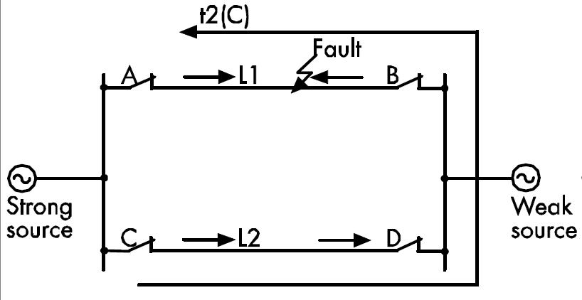
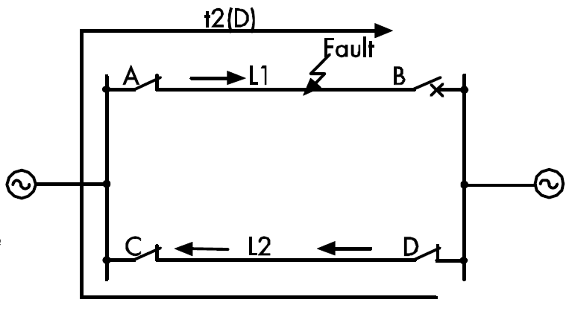

Current reversal guard:
A time delay tREVERSAL GUARD is required in case the overreaching trip element at end D operates before the signal send from the relay at end C has reset. Otherwise this would cause the relay at D to over trip.

Slide 52
Blocking Schemes

Slide 53
Blocking Scheme - Internal Fault
Z3
Z2
Z1
Z1
Send Logic : Z3 + Z2
Trip Logic : Rx + Z2
Z2
Z3
&
&
Rx Tx
Rx Tx
&
1 .
&
1 .
Z1
Trip
Trip
Z1
T2
Z2
Z2
T2
T2
Z3
T3
T3
Z3

Slide 54
Blocking Scheme - External Fault
Z3
Z2
Z1
Z1
Send Logic : Z3 + Z2
Trip Logic : Rx + Z2
Z2
Z3
&
&
Rx Tx
Rx Tx
&
1 .
&
1 .
Z1
Trip
Trip
Z1
T2
Z2
Z2
T2
T2
Z3
T3
T3
Z3

Slide 55
Blocking Scheme - Advantages
Fast tripping will still be possible at closed end of line for all fault positions with remote breaker open
Fast tripping will still be possible at strong infeed terminal for all fault positions where remote terminal has no or weak infeed

Slide 56
Blocking Scheme - Disadvantages
Historically only 2 forward zones of protection available (unless relay has >3 Zones)
If signalling channel fails supervision must revert the relay back to Basic scheme logic

Slide 57
Make the most of your energy™

